Slide 1

Team ByteForce
RAISE ‘25 DATA COMPETITION
Our Future With AI: Utopian or Dystopian?

Slide 2
INTRODUCING TEAM BYTEFORCE
Meet Our Team!
Roshni Gannoju (Team Member)
Expert in Database Systems
The ultimate threat to herself in real life (Her skills are sharp, but her surroundings might need a little extra caution!)
Sonal Shankar Udapudi (Team Member)
Master of Datasets
The clumsiest person you’ll meet, especially during peak moments! (Oops! )
Ayngaran Krishnamurthy (Team Leader)
Software Engineer
Skilled in Project Management & Programming
Overthinking life? Absolutely, it's my superpower!

Slide 3
INNOVATING WITH AI: WHAT LIES AHEAD?
AI is transforming industries and daily life, making the impossible possible at an incredible pace
AI is mastering language, pattern recognition, and decision-making, tackling tasks once reserved for humans.
Some trending evolutions include:
Self-Driving Cars
AI in Education
Explanatory AI (XAI)
With all the advancements in AI over the past years, we are left with a critical question: What does our future with AI truly hold—an optimistic utopia or a challenging dystopia?

Slide 4
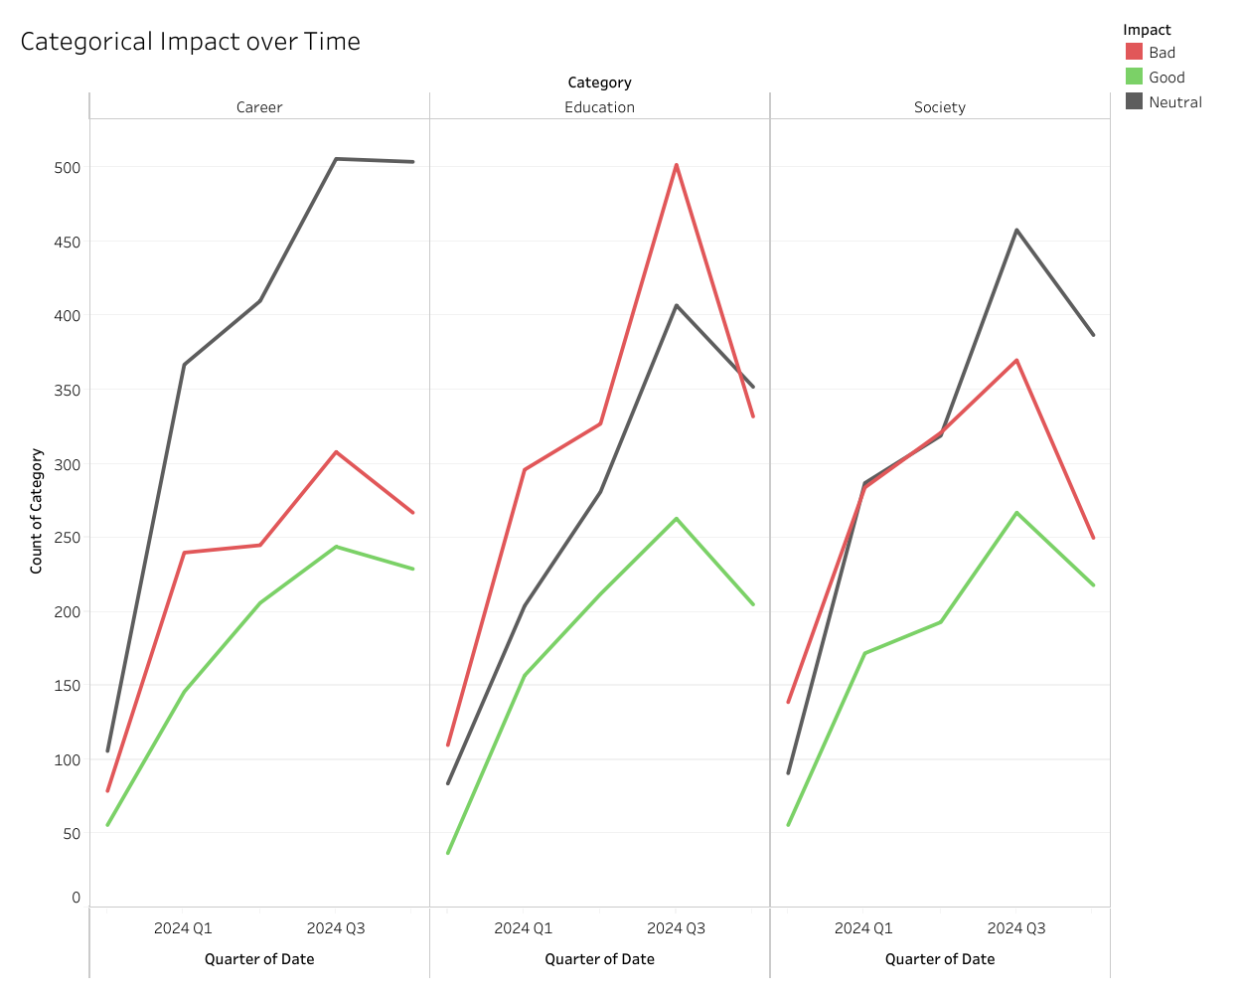
AI’S IMPACT OVER TIME (2023 Q4 - 2024 Q4)

Slide 5
AI’S IMPACT OVER TIME (2023 Q4 - 2024 Q4)
The line graph shows quarterly sentiment trends—Good, Neutral, and Bad—for Society, Career, and Education from Q4 2023 to Q4 2024.
Neutral sentiment remains steady, indicating no conclusive shift in public opinions across these fields.
Positive sentiment rises steadily for Career, while Education and Society experience sharp spikes in negativity in 2024 Q3.
The visualization captures how key events or advancements during this period may have influenced public perception.

Slide 6
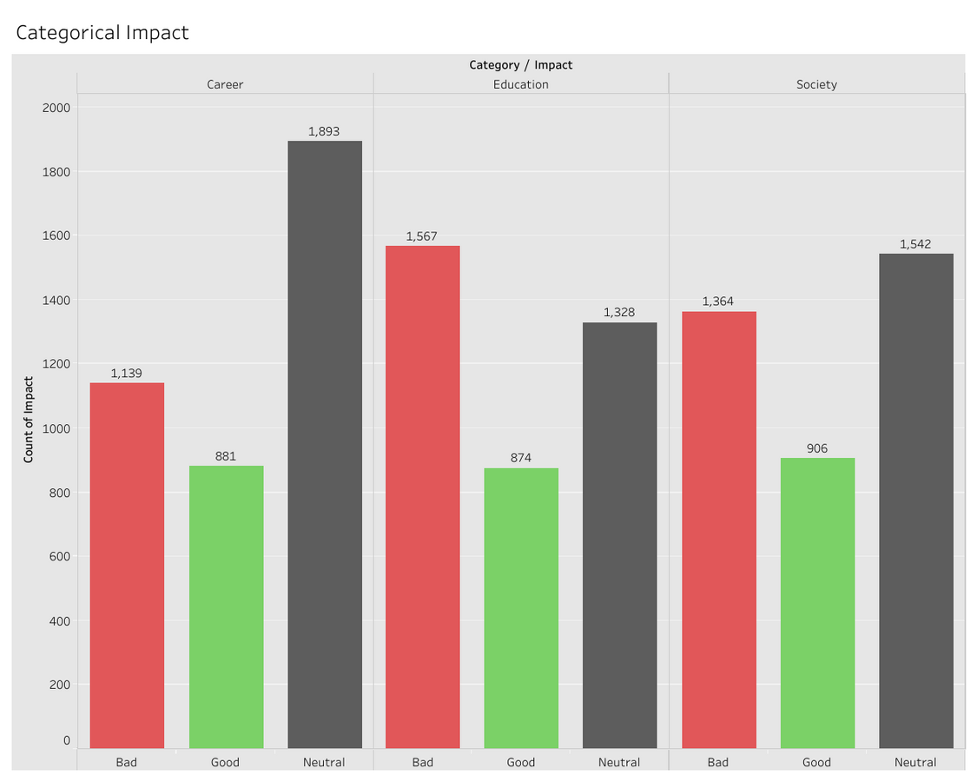
AI’S IMPACT ON VARIOUS FIELDS

Slide 7
AI’S IMPACT ON VARIOUS FIELDS
Building on the previous slide, this graph shows the distribution of Good, Neutral, and Bad sentiment across Society, Career, and Education.
Neutral sentiment dominates in all fields, reflecting uncertainty as people weigh the potential of AI.
Education has the highest Negative sentiment, driven by ethical concerns and challenges in adapting AI to learning.
The bar graph highlights how Education sparks polarizing debates, while Society and Career lean toward balanced discussions.

Slide 8
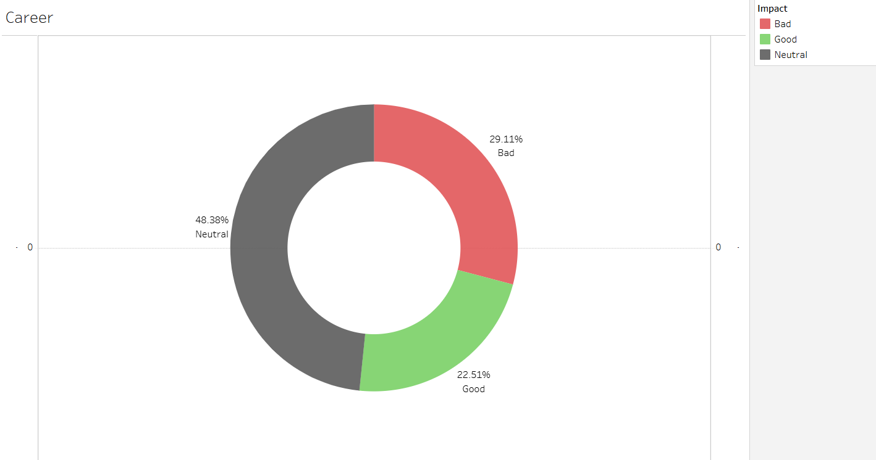
AI’S IMPACT ON CAREER

Slide 9
AI’S IMPACT ON CAREER
Building on Career’s breakdown in the previous slide, this donut chart shows Neutral (48.38%), Bad (29.11%), and Good (22.51%) sentiment.
Neutral sentiment dominates, reflecting a cautious but open mindset toward AI’s role in transforming jobs.
Negative sentiment highlights concerns like job automation and displacement, while Positive sentiment focuses on opportunities for innovation and growth.
The donut chart visually emphasizes that Neutral sentiment occupies nearly half, showing ongoing debates rather than fixed opinions.

Slide 10
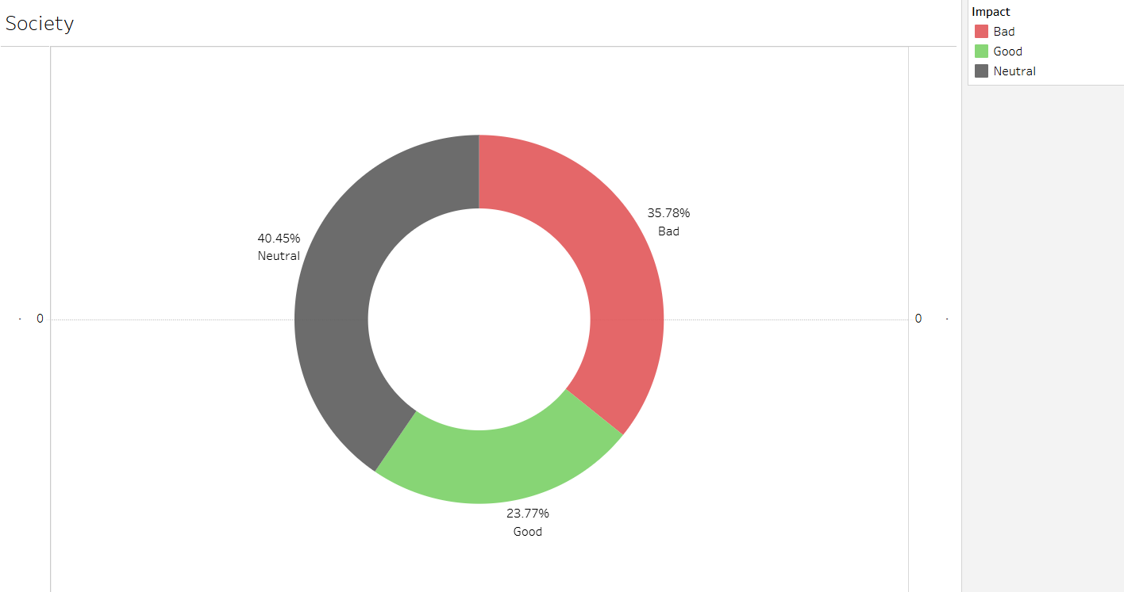
AI’S IMPACT ON SOCIETY

Slide 11
AI’S IMPACT ON SOCIETY
Following Society’s overview from the previous slide, this chart illustrates Neutral (40.45%), Bad (35.78%), and Good (23.77%) sentiment.
Neutral dominates, but the high Negative sentiment reflects concerns like privacy, misinformation, and ethical dilemmas.
Positive sentiment showcases the potential of AI to improve public services and support societal innovation.
The donut chart highlights a nearly equal division between Neutral and Negative views, showing society’s cautious stance toward AI’s role.

Slide 12
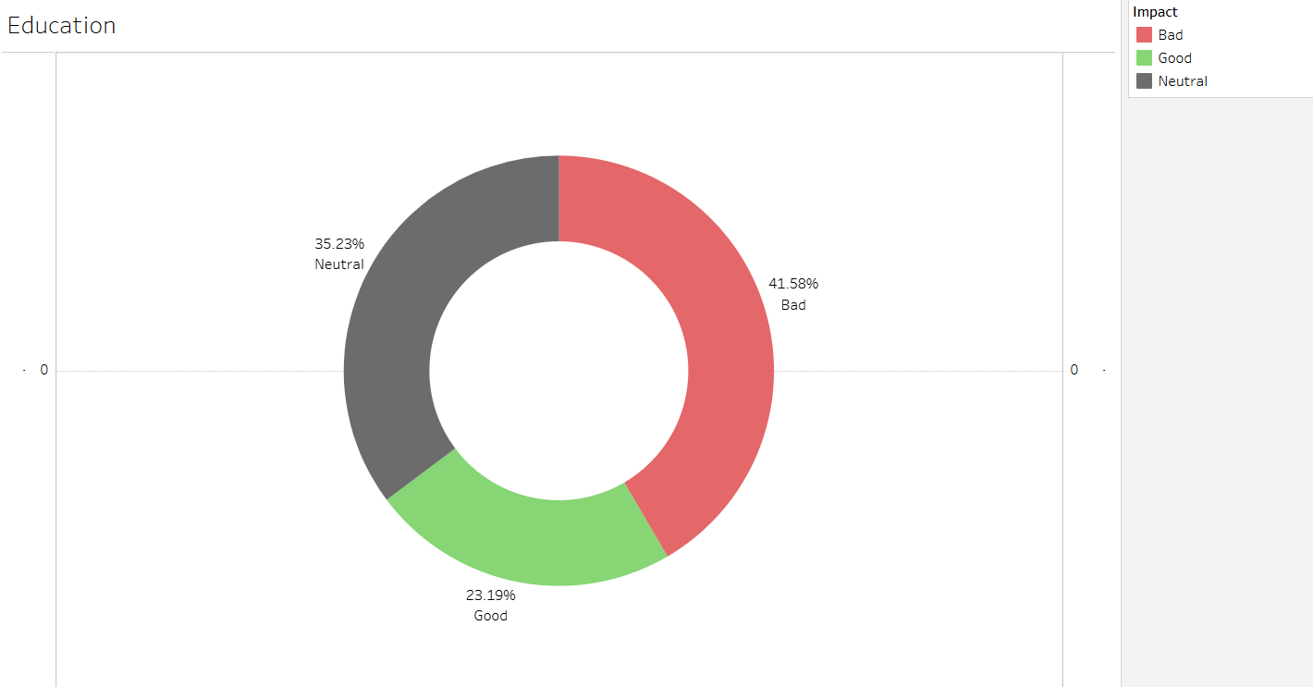
AI’S IMPACT ON EDUCATION

Slide 13
AI’S IMPACT ON EDUCATION
Continuing from Education’s breakdown in the previous slide, this chart shows sentiment: Bad (41.58%), Neutral (35.23%), and Good (23.19%).
Education has the highest Negative sentiment, driven by concerns like overreliance on AI, academic integrity, and teacher roles.
Neutral sentiment reflects ongoing evaluation, while Positive sentiment highlights benefits like personalized learning.
The chart underscores the dominance of Negative sentiment in Education, making it the most contentious field among the three.

Slide 14
DATA-DRIVEN CONCLUSION
So what does the data tell us? In Careers, Neutral dominates, but Positive sentiment is steadily growing, indicating cautious optimism.
Society has a strong Neutral perspective too, but the high Negative sentiment reflects ethical and privacy concerns that need addressing.
Education faces the highest skepticism, with more than 41% Negative sentiment. Clearly, there’s a long way to go before people trust AI in this space.
In the bigger picture, our future with AI isn’t utopia or dystopia—it’s a mix of opportunities and challenges.

Slide 15
DATA SPEAKS, BUT DO WE KNOW THE FULL STORY?
Thank you for giving us this platform to share our insights! But here’s a question: Is this data the whole story?
What if there’s more to uncover? Let’s dig a little deeper into the bigger picture of AI’s narrative.

Slide 16
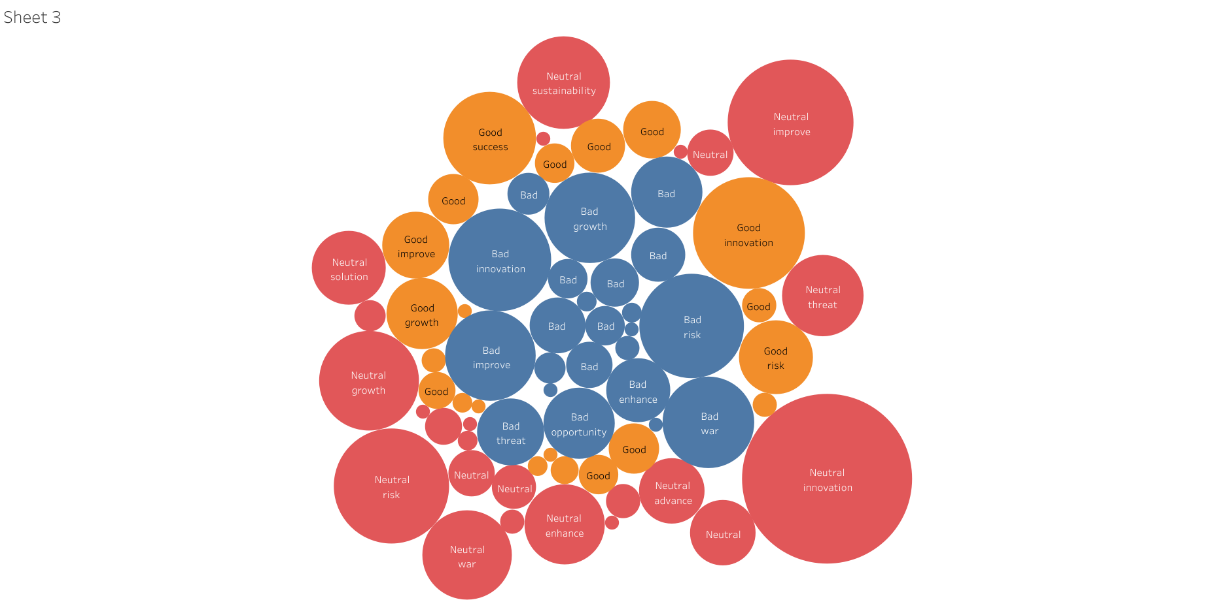
WORDS & CONSEQUENCES

Slide 17
WORDS & CONSEQUENCES
Let’s start by reflecting on the previous chart—did you notice something interesting? Words like 'growth,' 'improve,' and 'opportunity,' which we often associate with positive outcomes, appeared in Negative sentiment categories. On the other hand, words like 'risk' were part of Positive sentiment. Isn’t that surprising?
Sample Headlines from Dataset:
"Cultivating Trust in AI for Disaster Management" – Neutral ( Disaster)
"AI to Help GPs Identify Those at High Risk of Heart-Related Death" – Positive (Risk)
"Enterprise AI Adoption Key to Corporate Growth" – Negative (Growth)

Slide 18
PERCEPTIONS THROUGH AI
Take the headline about disaster management—'disaster' sounds negative but is used neutrally here. This shows how AI-related topics can be perceived differently depending on framing.
In the healthcare headline, ‘risk’ is positive, showing how AI can help save lives, despite the term’s usual negative association.
This emphasizes how emotional intelligence—something unique to humans—shapes our interpretation, but AI doesn’t share that context.

Slide 19
THE BIGGER PICTURE
As humans, we intuitively connect words like "disaster" and "risk" with negative outcomes. But when AI is trained, it doesn’t carry that emotional context.
AI doesn’t "feel" the word "disaster" as we do; it processes it based on the data given and might consider it in a neutral or even positive light depending on how we train it to be.
In AI's world, the context of words can be stripped of emotional connotations.

Slide 20
CRAFTING TOMORROW’S AI: A SHARED RESPONSIBILITY
Now, what does this mean for the future of AI? As Team ByteForce, we believe AI cannot inherently be "good" or "bad"—its nature is shaped entirely by us, the designers.
The key question is: How are we planning to develop AI? Will we ensure AI aligns with ethical standards, empathy, and human-centered values?
The future of AI isn’t predetermined—it depends on how we, as a society, choose to guide its development.
Will we build a world where AI enhances our lives in a responsible, ethical way, leading to a Utopia? Or will we let it spiral into a Dystopia due to neglect or harmful design choices?
The choices we make today will decide if AI becomes a tool for human flourishing or a catalyst for unforeseen challenges tomorrow.

Slide 21
THANK YOU
from
Team ByteForce

